Slide 1

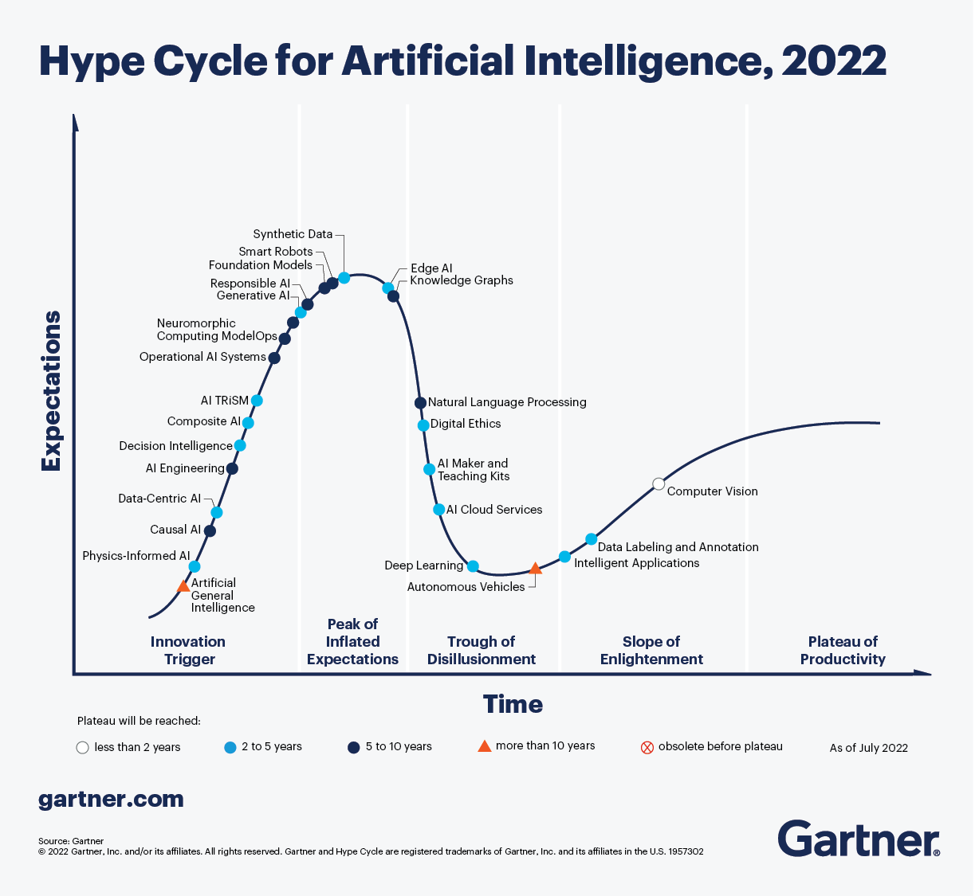
Meaningful Insights and Recommendations for Data Science Initiatives
MSCA 32018 NLP Final Project
02/27/2023
By: Paresh Raut

Slide 2

Agenda
1) Executive Summary
2) Methodology
3) Detect Topics
4) Sentiment Analysis - Timeline
5) Analysis of successful AI projects
6) Analysis of failing AI projects
7) Targeted Sentiment Analysis
8) Recommendations

Slide 3
Executive Summary
Business Problem
Insights & Recommendation
In today's industries, automation is extensively employed, wherein AI is utilized by companies to minimize expenses, save time, and reduce waste, while also enhancing productivity, reducing errors, and managing business processes in real-time. Nonetheless, there are several potential hazards and downsides associated with AI that can have unfavorable effects on humans.
Invest in R&D using new technology like ChatGPT to innovate new products. Companies can integrate projects with a cloud platforms. To improve cybersecurity and ethics, they can develop cutting-edge technology, perform market research, and focus on real-time and healthcare projects. Improving employee benefits will help retain top talent.

Slide 4






Methodology
Analyze the topics
and sentiments
trend in the data
Analyze why initiatives
were failing or succeeding
and suggest
recommendation
Clean up noise and
Remove remnants of web crawls
News articles related to trends in Data Science were collected
Analyze who was
spreading what sentiment
and when were they doing so
Filter to relevant articles related to Data Science.
(used the Gartener hype cycle)

Slide 5
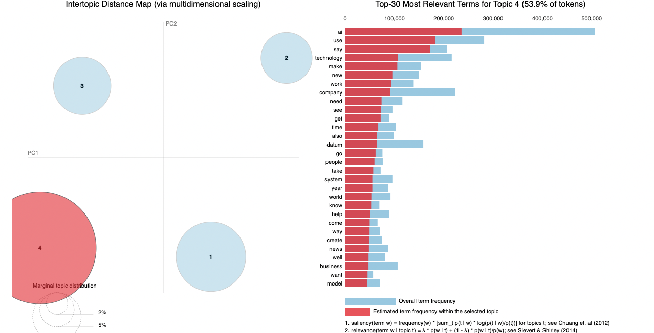
Detect Topics
I analyzed topic distribution using 2 techniques LDA and BerTopic modelling
1] LDA Results
186913 Articles related to
Data Science were about:
53.9%: Using AI technology in their Business (combined with news about it)
20.7%: Product growth and using AI for forecasting industry reports
14.1%: Using cloud services and
Including AI in their business
11.2%: AI being used in trade/stock markets to provide overview of market shares

Slide 6
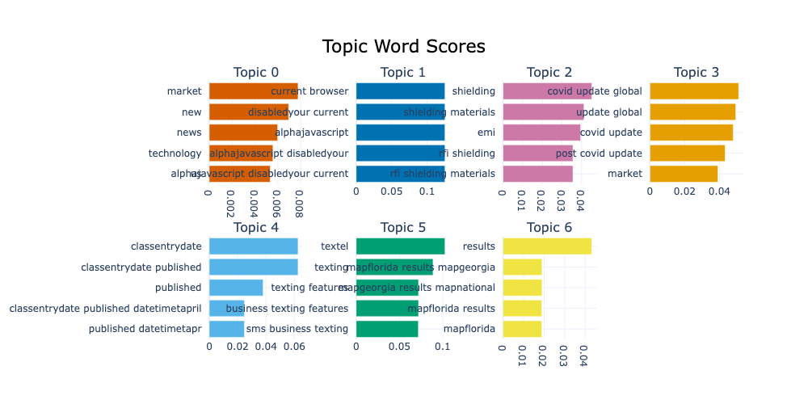
2] BerTopic Results
186913 Articles related to
Data Science were about:
Topic 0 : Market news about technology is the major topic in this collection of articles.
Topic 1 : Browser related issues
Topic 2 : Electrical Shielding Tape Market Analysis and Size
Topic 3 : Covid Related Info
Topic 4 : HVAC software market entry dates
Topic 5 :Business texting features
Topic 6 : Election results

Slide 7
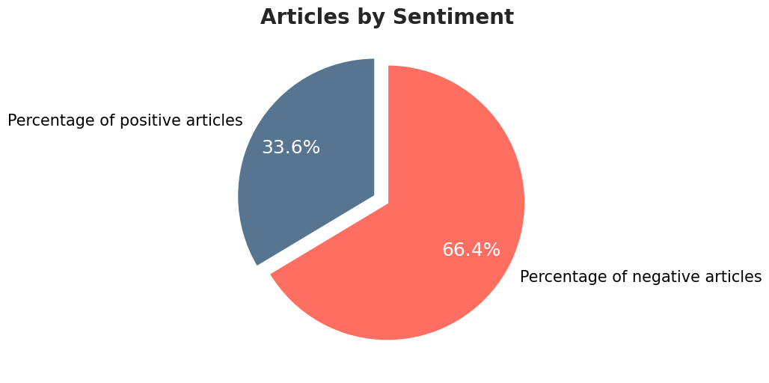
Sentiment Analysis
I trained multiple classifier models using Yelp data and found Logistic model to be most accurate. Further I applied the model
to the 186913 news articles to find following results :
To understand the sentiments by topics I also did some analysis there to find:
Articles related to Market news were in general of negative sentiment.
Even companies, people and locations were discussed majorly in negative sentiments.

Slide 8
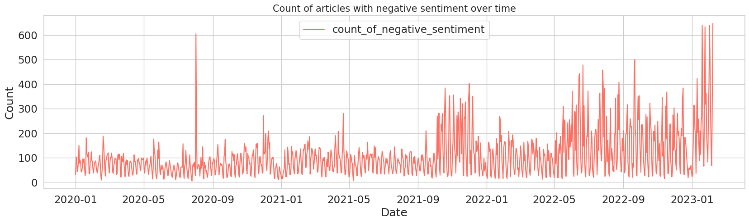
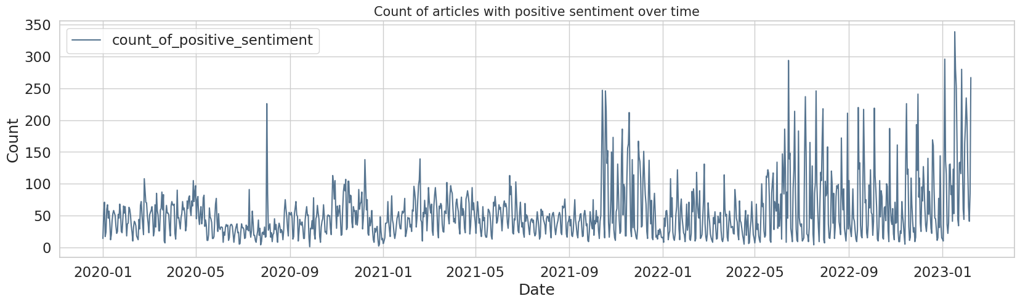
Sentiment Analysis - Timeline
As you can see the positive and negative sentiments varied in hype almost during the same time.
This might be happening because of some stock fluctuation or discussion of some new technology

Slide 9
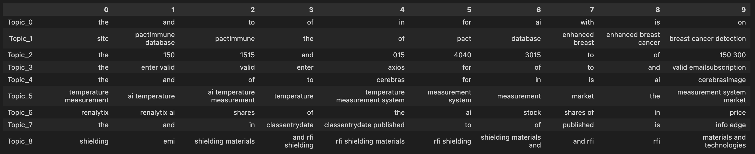
Analysis of successful AI projects
I analyzed what were the major topics in news articles which had Positive sentiment, I got the following results :
Enhanced Brest cancer detection techniques
Advanced Cerebrus Image recognition systems
Temperature Measurement tools using AI
Work done by Renalytix AI(Kidney Disease Identification) led to stock price increase
News about the rfi shielding material as an innovation

Slide 10
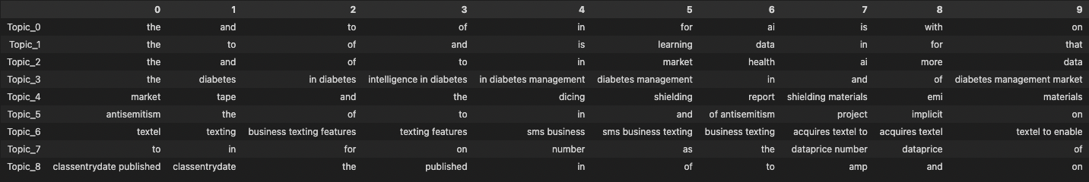
Analysis of failing AI projects
I analyzed what were the major topics in news articles which had a negative sentiment, I got the following results :
Declining Market health and stock prices was a reason.
Projects focused on intelligence in diabetes management were failing
Projects related to shielding materials related to dicing were failing
Business texting features were not a great project

Slide 11
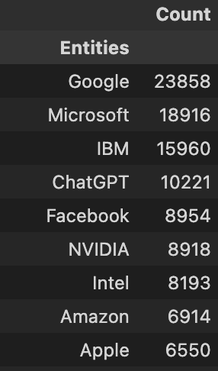
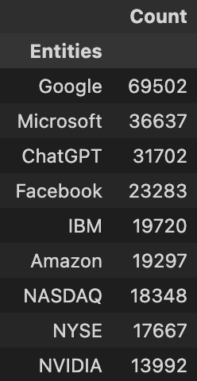
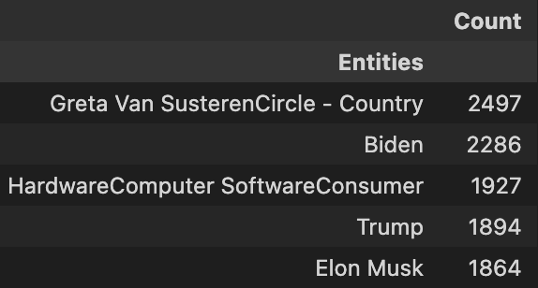
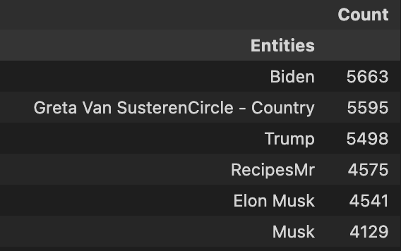

Targeted Sentiment Analysis
Organizations
People
Positive sentiment
Negative sentiment
Positive sentiment
Negative sentiment
For the Distribution of people , again I saw people being discussed in negative sentiments more than positive sentiments. Trump and Elon Musk were disscused much more in negative articles than anyone else
In General, I observed that companies were discussed in negative sentiment more than positive sentiment. To Highlight some major findings ChatGPT has 77% articles with negative sentiments and Amazon had the highest percentage of negative articles compared to any other organization.

Slide 12
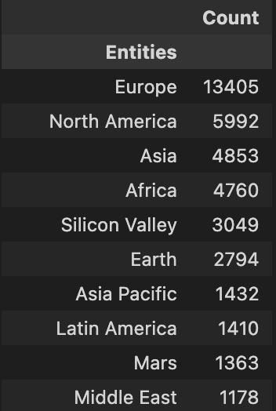
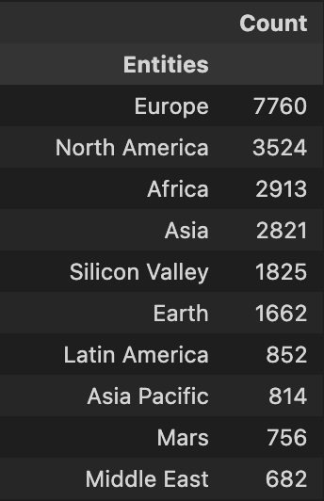
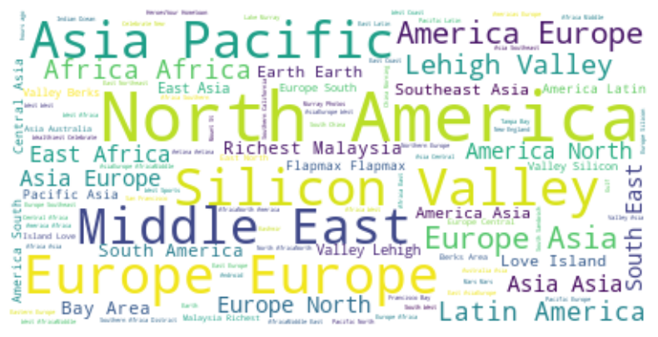
Targeted Sentiment Analysis
Location
Negative sentiment
Positive sentiment
Locations also follow a higher percentage discussion in negative articles. Almost all locations had an equal split of discussion in negative and positive articles.

Slide 13
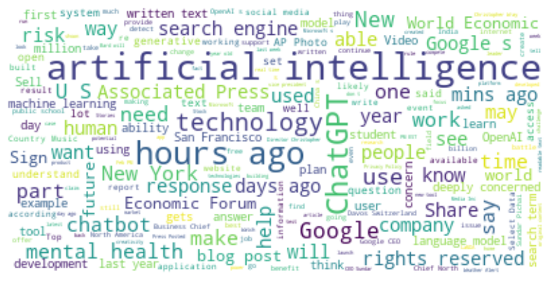
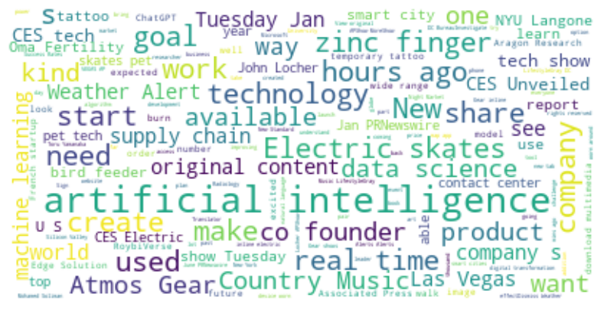
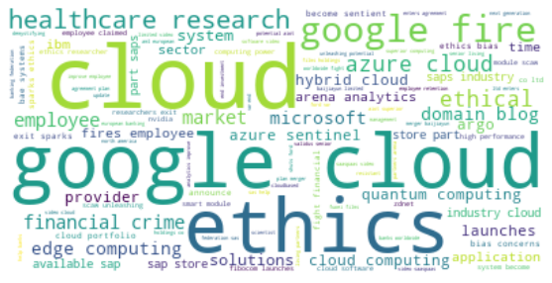
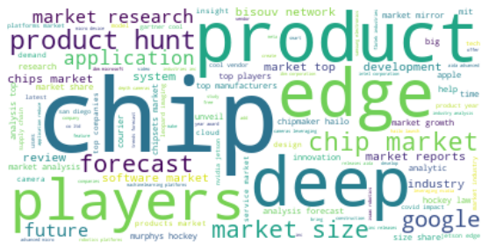
Recommendations
Actions to increase success rate of AI project, I analyzed words mostly discussed in Hype cycles/ Sentiment timelines and made a filter of possible things to improve from negative hype and things to be continued from positive hype.
Invest in R&D for new product innovation using newer technology like ChatGPT.
Develop cutting edge technology for market research.
Improve cybersecurity and maintain ethics using the new tech.
Promote integrating projects with cloud platforms.
Boost real-time projects and Healthcare projects.
Improve employee benefits.

Slide 14
Thank You

